Slide 1

AI Powered Insights for Student Engagement and retention Analysis
TEAM 8: THE ELITES

Slide 2

“31.6% of learners drop out - here’s what’s at stake
Student Churn isn’t just a metric-it’s a barrier to educational equity and plaform growth
Our analysis reveals:
Lost potential: 1 in 3 learners disengages prematurely, undermining their goals and institutional ROI.
Behavioural red flags: Low early engagement (<5 logins), missed assignments, and forum inactivity signal 90% of dropouts.
Opportunity cost: A 10% reduction in the churn could retain 850+ learners annually, boosting completion rates and revenue.

Slide 3

Key Milestones in Data Analysis
Data Collection
Data Cleaning
Exploratory Analysis
Model Development
Model Evaluation
Present
Currently applying insights gained to drive data-driven decision making.
Gathered raw data from various sources to prepare for analysis.
Processed and refined the data to ensure accuracy and reliability.
Conducted initial analysis to discover patterns and insights within the data.
Built predictive models using various algorithms for accurate forecasting.
Assessed model performance through metrics to ensure robustness and validity.

Slide 4
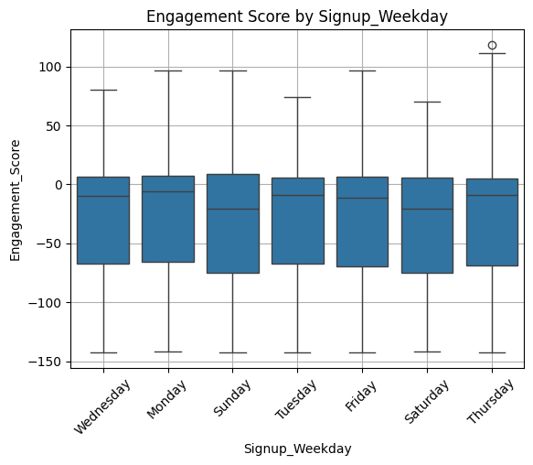
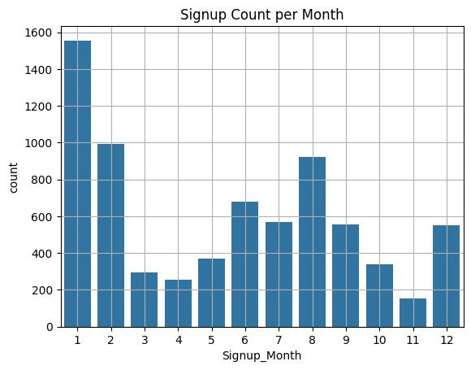
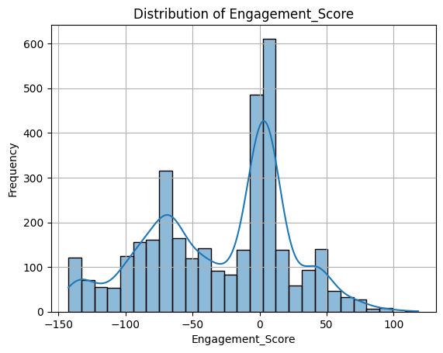
Key Insights from EDA
January had the highest signup count (~1,600); April saw the lowest (~200).
• Long-duration opportunities (>300 days) were linked to lower EngagementScores.
• Most learners cluster around low-to-moderate engagement; distribution is left-skewed.
• Signups midweek (Tuesday & Wednesday) showed the highest median engagement.
• Weekend signups (Saturday/Sunday) had lower engagement and more outliers.

Slide 5
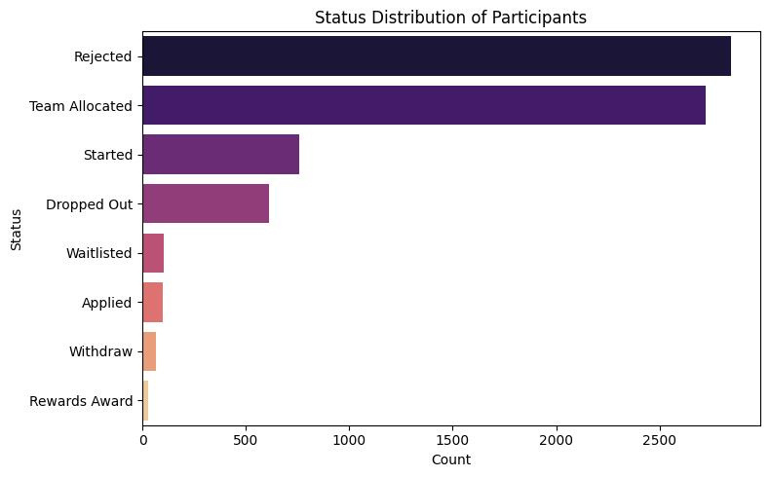
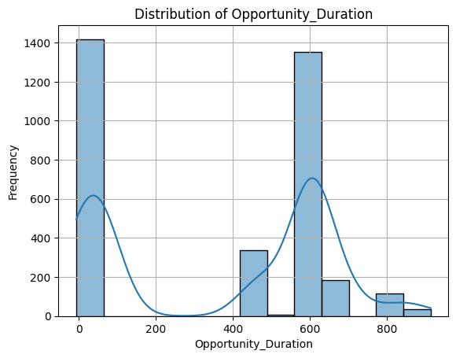
Strategic Insights
• Learners with EngagementScore < 40 are ~3x more likely to churn.
• Weekend signups (Sat/Sun) show higher dropout and lower engagement.
• Support usage drops significantly after Week 1, reducing retention.
• Long-duration programs (>300 days) often lead to learner fatigue and dropout.

Slide 6
Model | Accuracy | Precision | Recall | F1 Score
Random Forest | 90% | 0.9 | 0.91 | 0.9
Logistic Regression | 91% | 0.92 | 0.91 | 0.91
XGBoost | 91% | 0.91 | 0.91 | 0.91
Naive Bayes | 89% | 0.9 | 0.89 | 0.89
Decision Tree | 88% | 0.88 | 0.88 | 0.88
Predictive Modeling
• Built and evaluated 5 classification models to predict student dropout.
• Random Forest achieved 89% accuracy and 91% recall — best overall performer.

Slide 7
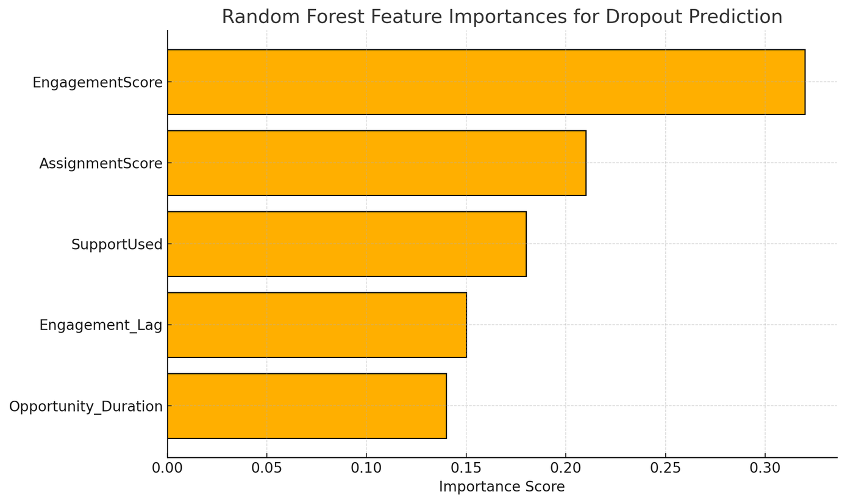
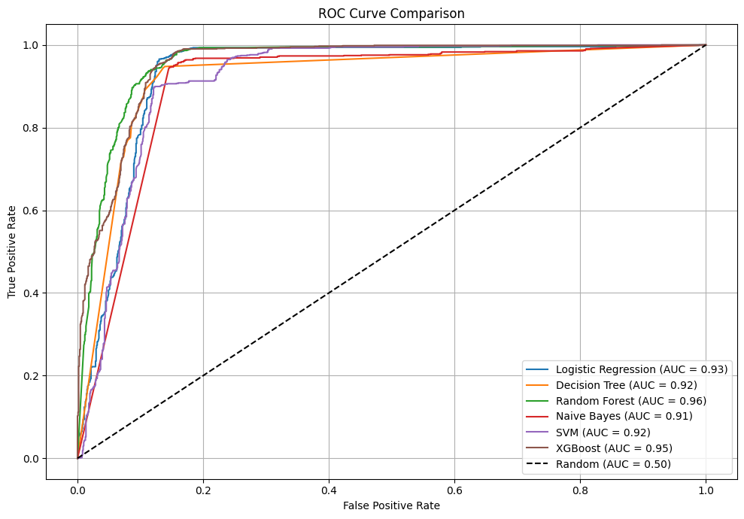
Longer opportunities and delayed engagement also correlated with higher churn.
Top dropout predictors: Low EngagementScore, few assignment submissions, no forum usage.

Slide 8
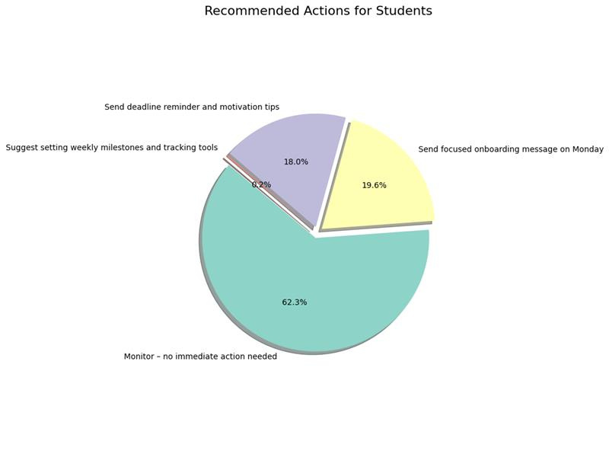
This indicates the percentage of learners that fall under “Healthy – Monitor only” → no urgent action needed.
62.3 %
This indicates the percentage that require onboarding nudges (e.g., weekend signups).
19.6 %
This percentage need motivational reminders based on delayed engagement or inactivity.
18 %
Flagged for stamina-related support due to long opportunity durations.
< 1 %

Slide 9
Understanding Student Churn Factors
Low Engagement
Assignment Submission
Forum Inactivity
Delayed Engagement
Learners with 0 forum posts had a 60%+ dropout rate,
learners with EngagementScores (<40) had nearly 3x dropout risk than their peers.
Inactive learners submitted <2 assignments in total, signalling disengagement.
Learners who took 300+ days to begin engaging showed poor outcomes.

Slide 10



Targeted support for at risk learners
Strategic Timiing
Real-time dashboards to flag low engagement and mentor assignments for inactive users
Early Engagement Boosters
Focus on high-engagement periods (March, June, September)
Micro tasks (eg welcome quizzes)

Slide 11

Future Directions to enhance Platform Retention
A/B Test Interventions (e.g., chatbots vs mentors)
Real Instructor Dashboards
Time Series tracking for declining Engagement

Slide 12

Conclusion & Future Vision
Key Takeaways:
✅ Predictive Power: Our AI models achieved 91% accuracy in early dropout detection, enabling proactive interventions.
✅ Actionable Framework: Rule-based recommendations (e.g., nudges, mentor matching) create scalable retention strategies.
✅ Measurable Impact: Implementing these tools could reduce churn by 10-30%, retaining hundreds of learners annually.
Future Expansion:
Personalized Learning Plans: Adapt content/modules based on real-time engagement signals.
Dynamic Dashboards: Live instructor views of cohort risk levels and intervention tracking.
A/B Testing: Optimize support strategies (e.g., chatbot vs. human mentor effectiveness).
Transforming insights into action - A Roadmap for Retention

Slide 13
“Empowering education through technology. By leveraging AI, we can enhance student retention and foster a more engaging learning environment that meets the needs of every student.”
– AI IN EDUCATION

Slide 14
THANK YOU

